Slide 1
System Administration and Management
ET 8413
ET 8413
Unit I
System Administration & IT Infrastructure

Slide 2
Introduction
ET 8413
System administration refers to the management, configuration, maintenance, and troubleshooting of computer systems, servers, networks, and IT infrastructure to ensure their optimal performance, security, and availability.
A system administrator (sysadmin) ensures that an organization's IT systems run smoothly, securely, and efficiently.

Slide 3
Introduction
ET 8413
System Comprise of
Computers
Networks
Users
Any thing else?

Slide 4
Duties of System Administrator
ET 8413
Applying operating system updates, patches, and configuration changes.
Installing and configuring new hardware and software.
Adding, removing, or updating user account information, resetting passwords, etc.
Responsibility for documenting the configuration of the system.
Responsibility for security.

Slide 5
Duties of System Administrator
ET 8413
Performing routine audits of systems and software.
Performing backups.
Analyzing system logs and identifying potential issues with computer systems.
Troubleshooting any reported problems.
Introducing and integrating new technologies into existing data center environments.
Answering technical queries.

Slide 6
Types of Administrators
ET 8413
In a larger company, following may all be separate positions within a computer support or Information Services (IS) department.
In a smaller group they may be shared by a few sysadmins, or even a single person.
A database administrator (DBA) maintains a database system, and is responsible for the integrity of the data and the efficiency and performance of the system.

Slide 7
Types of Administrators
ET 8413
A network administrator maintains network infrastructure such as switches and routers, and diagnoses problems with these or with the behavior of network-attached computers.
A security administrator is a specialist in computer and network security, including the administration of security devices such as firewalls, as well as consulting on general security measures.

Slide 8
Types of Administrators
ET 8413
A web administrator maintains web server services (such Apache) that allow for internal or external access to web sites. Tasks include managing multiple sites, administering security, and configuring necessary components and software.
Technical support staff respond to individual users' difficulties with computer systems, provide instructions and sometimes training, and diagnose problems.

Slide 9
Operating systems supporting Administration
ET 8413
System administrators work with various operating systems (OS) depending on the organization's needs. The most commonly used OS in system administration include:
Windows-Based Operating Systems: Windows Server is widely used in corporate environments, especially where Active Directory (AD) and Microsoft-based services are required.

Slide 10
Operating systems supporting Administration
ET 8413
Windows Server Versions for SysAdmins:
Windows Server 2022 (Latest stable version)
  Features: Active Directory, Hyper-V, PowerShell, Azure integration.
Windows Server 2019 (Still widely used)
Windows Server 2016 (Legacy support)
Linux Distributions (Open-Source & Enterprise):Popular for web servers, cloud computing, and DevOps environments.

Slide 11
Operating systems supporting Administration
ET 8413
Windows Server Versions for SysAdmins:
Windows Server 2022 (Latest stable version)
  Features: Active Directory, Hyper-V, PowerShell, Azure integration.
Windows Server 2019 (Still widely used)
Windows Server 2016 (Legacy support)
Linux Distributions (Open-Source & Enterprise):Popular for web servers, cloud computing, and DevOps environments.

Slide 12
Operating systems supporting Administration
ET 8413
Popular Distros:
  Ubuntu Server – User-friendly with strong community support
  CentOS / Rocky Linux – Stable and widely used for hosting
  Red Hat Enterprise Linux (RHEL) – Enterprise-grade with commercial support
  Debian – Reliable and secure for long-term use

Slide 13
Operating systems supporting Administration
ET 8413
macOS in System Administration: While not common for servers, macOS is used in:
  Managing Apple devices in an enterprise (Jamf Pro, MDM)
  DevOps & development environments (Unix-like terminal)

Slide 14
System Administration Tools
ET 8413
SysAdmins use a variety of tools to monitor, manage, and automate IT infrastructure.
Wireshark – Packet capture and network analysis
Nagios- Network & server monitoring (alerts for outages).
Nessus- Vulnerability scanning.
Nmap – Network scanning and security auditing

Slide 15
Physical Layer
OSI Model
Provides physical interface for transmission of information.
Defines rules by which bits are passed from one system to another on a physical communication medium.
Covers all - mechanical, electrical, functional and procedural - aspects for physical communication.
Such characteristics as voltage levels, timing of voltage changes, physical data rates, maximum transmission distances, physical connectors, and other similar attributes are defined by physical layer specifications.

Slide 16
Data Link Layer
OSI Model
Data link layer attempts to provide reliable communication over the physical layer interface.
Breaks the outgoing data into frames and reassemble the received frames.
Create and detect frame boundaries.
Handle errors by implementing an acknowledgement and retransmission scheme.
Implement flow control.
Supports points-to-point as well as broadcast communication.
Supports simplex, half-duplex or full-duplex communication.

Slide 17
Network Layer
OSI Model
Implements routing of frames (packets) through the network.
Defines the most optimum path the packet should take from the source to the destination
Defines logical addressing so that any endpoint can be identified.
Handles congestion in the network.
Facilitates interconnection between heterogeneous networks (Internetworking).
The network layer also defines how to fragment a packet into smaller packets to accommodate different media.

Slide 18
Transport Layer
OSI Model
Purpose of this layer is to provide a reliable mechanism for the exchange of data between two processes in different computers.
Ensures that the data units are delivered error free.
Ensures that data units are delivered in sequence.
Ensures that there is no loss or duplication of data units.
Provides connectionless or connection oriented service.
Provides for the connection management.
Multiplex multiple connection over a single channel.

Slide 19
Session Layer
OSI Model
Session layer provides mechanism for controlling the dialogue between the two end systems. It defines how to start, control and end conversations (called sessions) between applications.
This layer requests for a logical connection to be established on an end-user’s request.
Any necessary log-on or password validation is also handled by this layer.
Session layer is also responsible for terminating the connection.
This layer provides services like dialogue discipline which can be full duplex or half duplex.
Session layer can also provide check-pointing mechanism such that if a failure of some sort occurs between checkpoints, all data can be retransmitted from the last checkpoint.

Slide 20
Presentation Layer
OSI Model
Presentation layer defines the format in which the data is to be exchanged between the two communicating entities.
Also handles data compression and data encryption (cryptography).

Slide 21
Application Layer
OSI Model
Application layer interacts with application programs and is the highest level of OSI model.
Application layer contains management functions to support distributed applications.
Examples of application layer are applications such as file transfer, electronic mail, remote login etc.

Slide 22
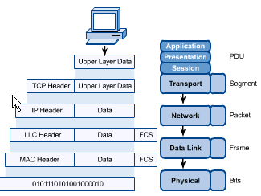
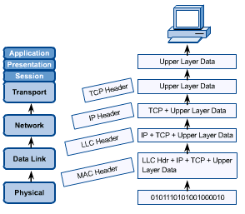
OSI in Action
OSI Model
A message begins at the top application layer and moves down the OSI layers to the bottom physical layer.
As the message descends, each successive OSI model layer adds a header to it.
A header is layer-specific information that basically explains what functions the layer carried out.
Conversely, at the receiving end, headers are striped from the message as it travels up the corresponding layers.

Slide 23
TCP/IP Model
TCP/IP MODEL

Slide 24
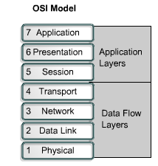
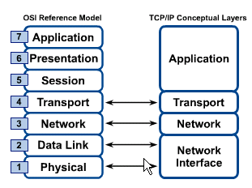
OSI & TCP/IP Models
TCP/IP Model

Slide 25
TCP/IP Model
TCP/IP Model
Application Layer
Application programs using the network
Transport Layer (TCP/UDP)
Management of end-to-end message transmission,
error detection and error correction
Network Layer (IP)
Handling of datagrams : routing and congestion
Data Link Layer
Management of cost effective and reliable data delivery,
access to physical networks
Physical Layer
Physical Media

